Slide 1
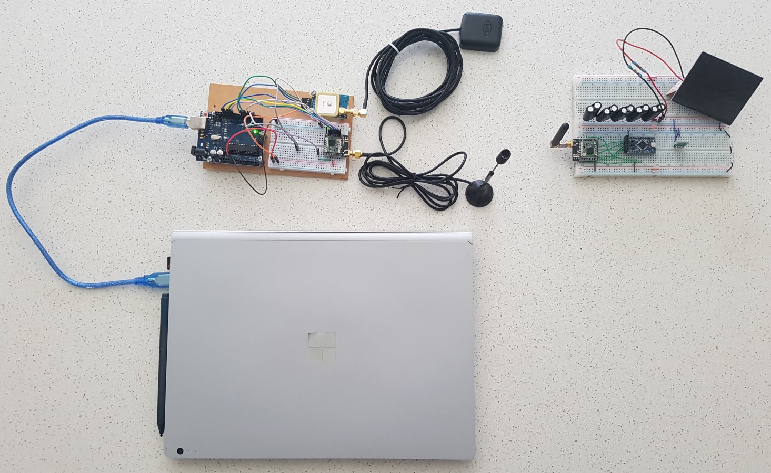
Design of a small satellite UHF radio beacon for Identification, Telemetry, Tracking and Control
Presented by Pilot Officer Travis McKee
Thesis Supervisors: Dr Edwin Peters & Dr Craig Benson
Notes:
Good morning, my name is Pilot Officer McKee and I am to present my thesis project
The design of a small satellite UHF radio beacon for identification, telemetry, tracking and control.

Slide 2
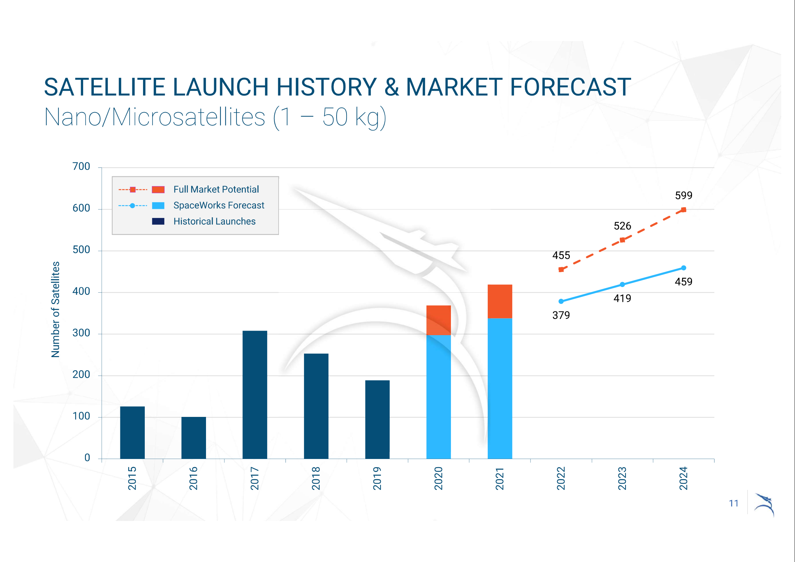
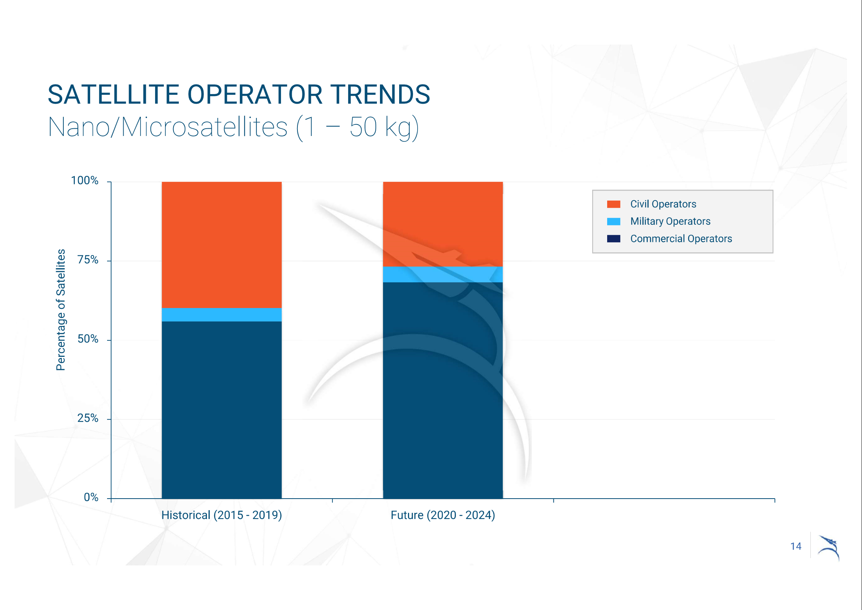
Introduction
“mission success rates average 45 percent and 77 percent between academia and industry, respectively”
U.S. Space program Mission Assurance Improvement Workshop
Source: Space Works, 2020 Nano/Microsatellite market forecast, 10th edition,
Accessed at: https://www.spaceworks.aero/nano-microsatellite-forecast-10th-edition-2020/
“SpaceWorks estimates 1,800 – 2,400 nano/microsatellites will require launch over the next 5 years”
2020 Nano/Microsatellites market forecast, 10th Edition
Source: Space Works, 2020 Nano/Microsatellite market forecast, 10th edition,
Accessed at: https://www.spaceworks.aero/nano-microsatellite-forecast-10th-edition-2020/
Notes:
It is estimated up to 2400 satellites will launch into Low Earth Orbit over the next 5 years.
This is a result of a significant decrease in cost to design, manufacture and launch a small satellite
A considerable amount of satellites are launched into the LEO environment by organizations with little to no space experience
This has resulted in a mission failure rate of 55% for academic institutions and 23% for commercial enterprises.

Slide 3

Introduction
Additional challenges for monitoring and operating in the Low Earth Orbit (LEO) environment:
Increased demand on resource expensive space monitoring equipment to maintain Space situational awareness (SSA)
An increase in space debris due to a large failure rate of small satellites
Difficulties in identifying small objects in the LEO environment
Image source: Universe Today, Space and astronomy news
Accessed at: https://www.universetoday.com/85322/what-is-low-earth-orbit/
Notes:
These two conditions have produced additional challenges for monitoring and operating in the LEO environment due to the increased number of satellites and space debris
Research has identified three problems to be addressed:
The increased demand on resource expensive space monitoring equipment to maintain Space Situational Awareness
2. The large failure rate of small satellites leading to an increase in space debris objects
3. The increased difficulties in identifying small objects in the LEO environment

Slide 4
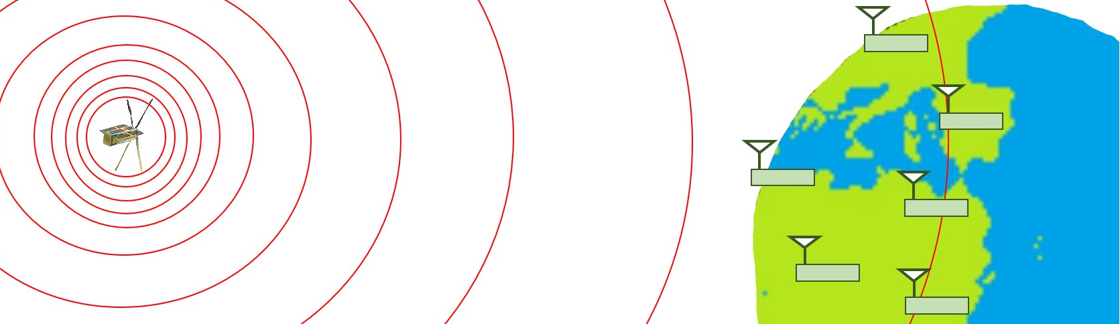
Introduction
The purpose of this project is to design a satellite UHF radio beacon system which provides:
A better technique of uniquely identifying an object in LEO
A cost-effective system of tracking objects
A method of obtaining satellite telemetry data irrespective of a failure in any other system
An alternative communications pathway for satellite control
Notes:
To address the identified problems, the design of a satellite UHF radio beacon system is proposed to provide:
A better technique of uniquely identifying an object in LEO
A cost-effective system that can track active, End of Life and failed satellites
A method of obtaining satellite telemetry or health data irrespective of a failure in any other satellite system
An alternative communications pathway for satellite control

Slide 5
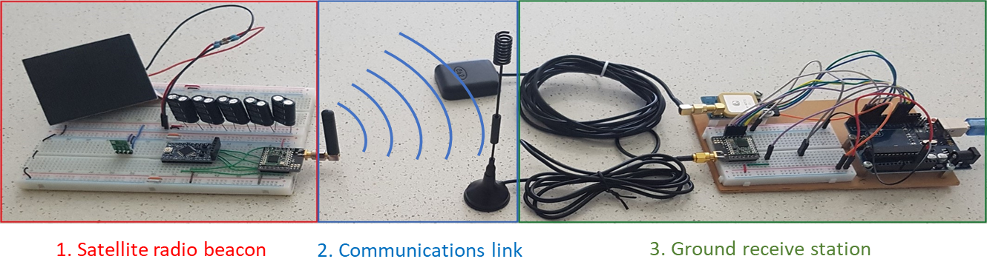
Theory of Operation
The Satellite UHF radio beacon system will be separated into 3 components:
The satellite radio beacon – A self-sustained system that can operate independently of all other satellite systems
The communications link – Supports the transmission of data from the radio beacon in LEO to a ground receiving station (2000km slant range)
The ground receiving station – Captures the transmitted data, records the precise time of arrival (TOA) and passes data to a peripheral device.
Notes:
The Satellite UHF radio beacon system will be separated into 3 components:
The satellite radio beacon – That is a self-sustained and independent UHF communication system
The communications link – which supports the transmission of data for a range of 2000km
The ground receiving station – which can capture the transmitted data, record the RF signals time of arrival and pass this data to a peripheral device for processing.

Slide 6
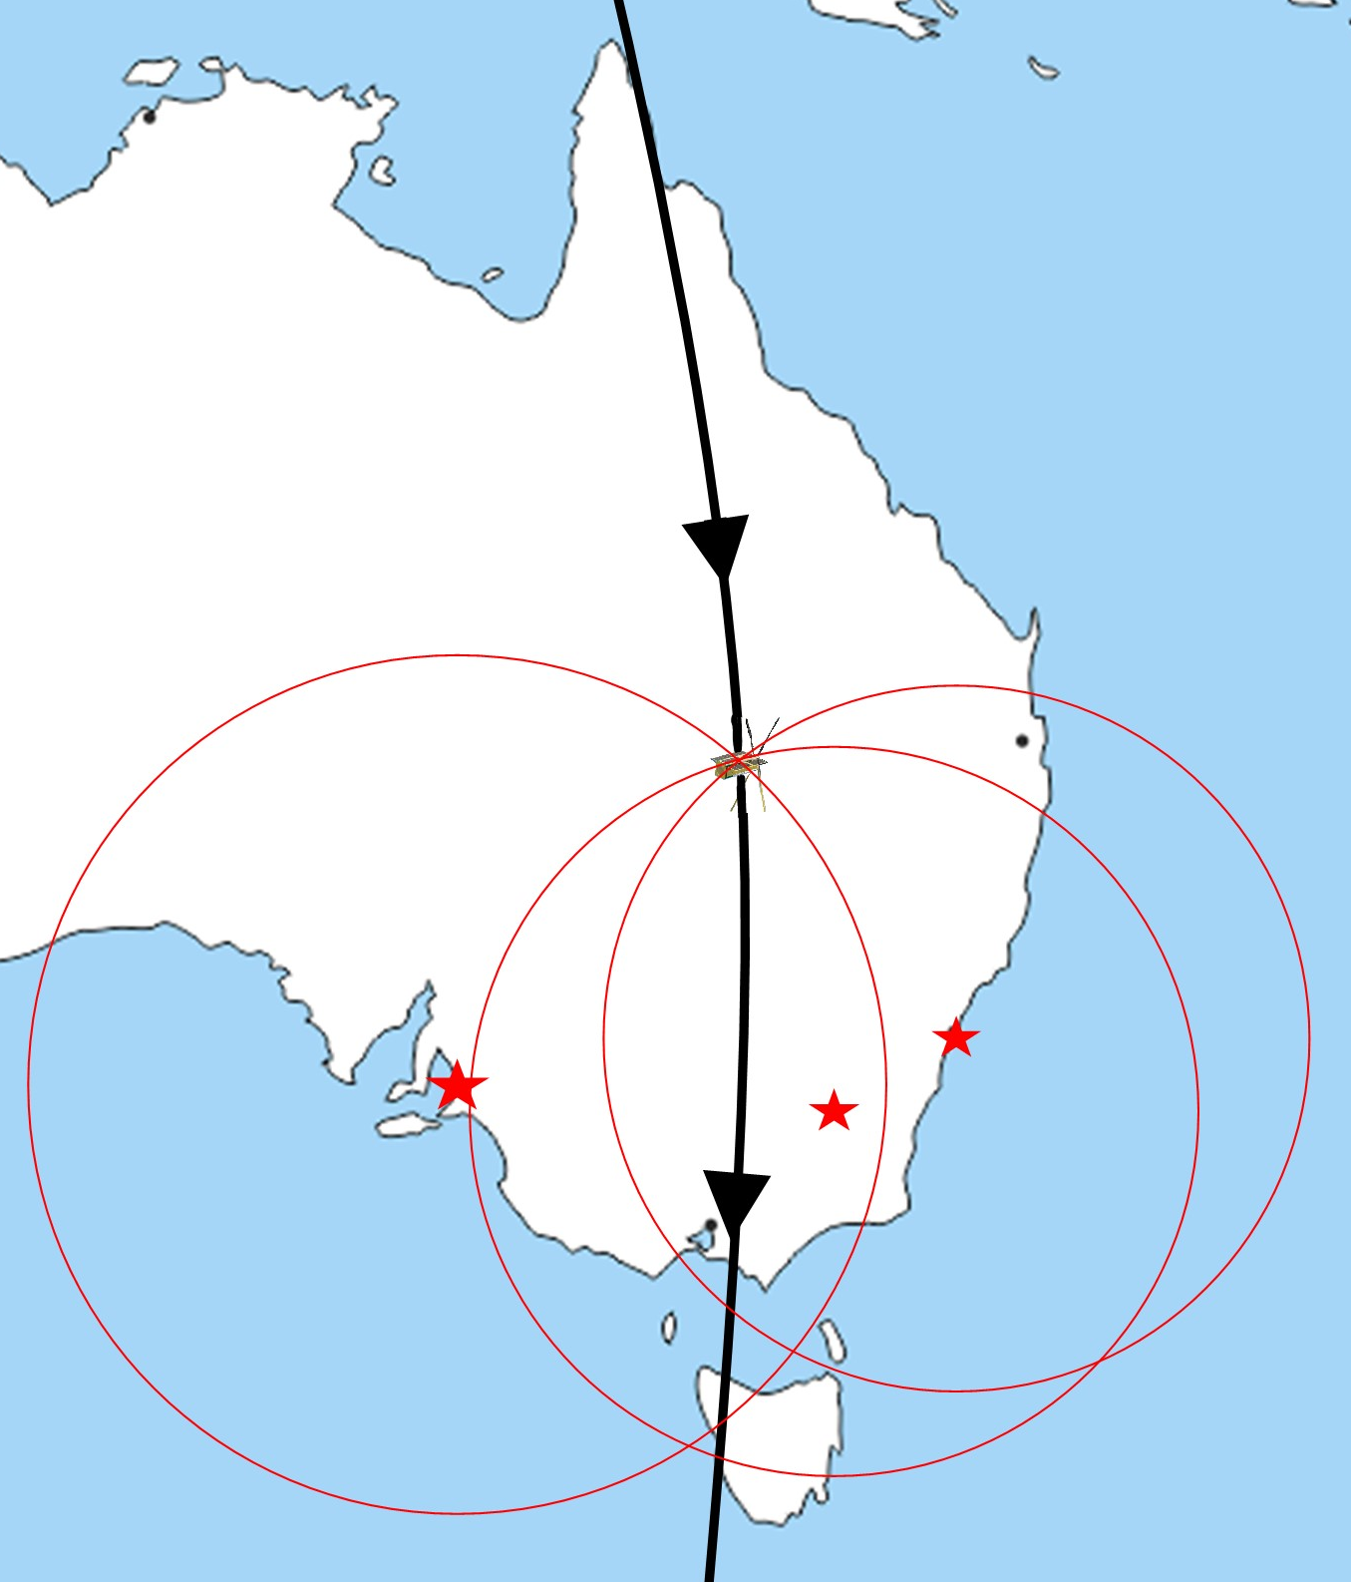
Theory of Operation
The satellite beacon periodically transmits the collected telemetry data and a unique address from the UHF radio
Followed by a period where command data can be received
The transmitted data is collected with the measured time of arrival at multiple graphically dispersed ground stations
The collected data and timestamps are passed along to a peripheral device for processing.
The time difference of arrival (TDOA) between the three ground stations allows for the calculation of the satellites estimated position
Notes:
The satellite beacon can be linked with other satellite systems to collect telemetry data and contains a unique 16-Bit address
This information is placed into data packets and periodically transmitted from the beacon’s UHF radio
This is followed by a short period of time where command data can be received by the radio.
The data transmitted from the beacon is collected at multiple graphically dispersed ground stations with a timestamp of the signals precise time of arrival.
This data is then passed to a peripheral device where the satellites estimated position can be calculated using the time difference of arrival between three ground stations

Slide 7
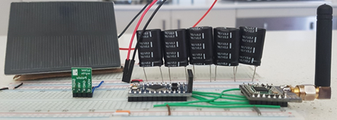
Satellite Radio Beacon
The satellite radio beacon must be self-sustaining and independent of all other satellite systems
To achieve these aims the beacon contains its own:
Processor –Arduino Pro Mini (APM) module containing an ATMEGA328 processor
Radio Transceiver –RFM96 LoRa radio module, which uses an ultra-long range spread spectrum communication techniques
Power Generation, Storage and Regulation – 0.5W Silicon solar panel, super-capacitor storage system and a buck converter regulator
Notes:
The satellite UHF radio beacon must be self-sustaining and independent of all other satellite systems
To achieve these aims the beacon must contain its own:
Processor – that is a Arduino Pro Mini (APM) module
Radio Transceiver – which is a RFM96 LoRa radio module
Power Generation, Storage and Regulation – which contains silicon solar panels, a super-capacitor storage system and a buck converter for power regulation

Slide 8
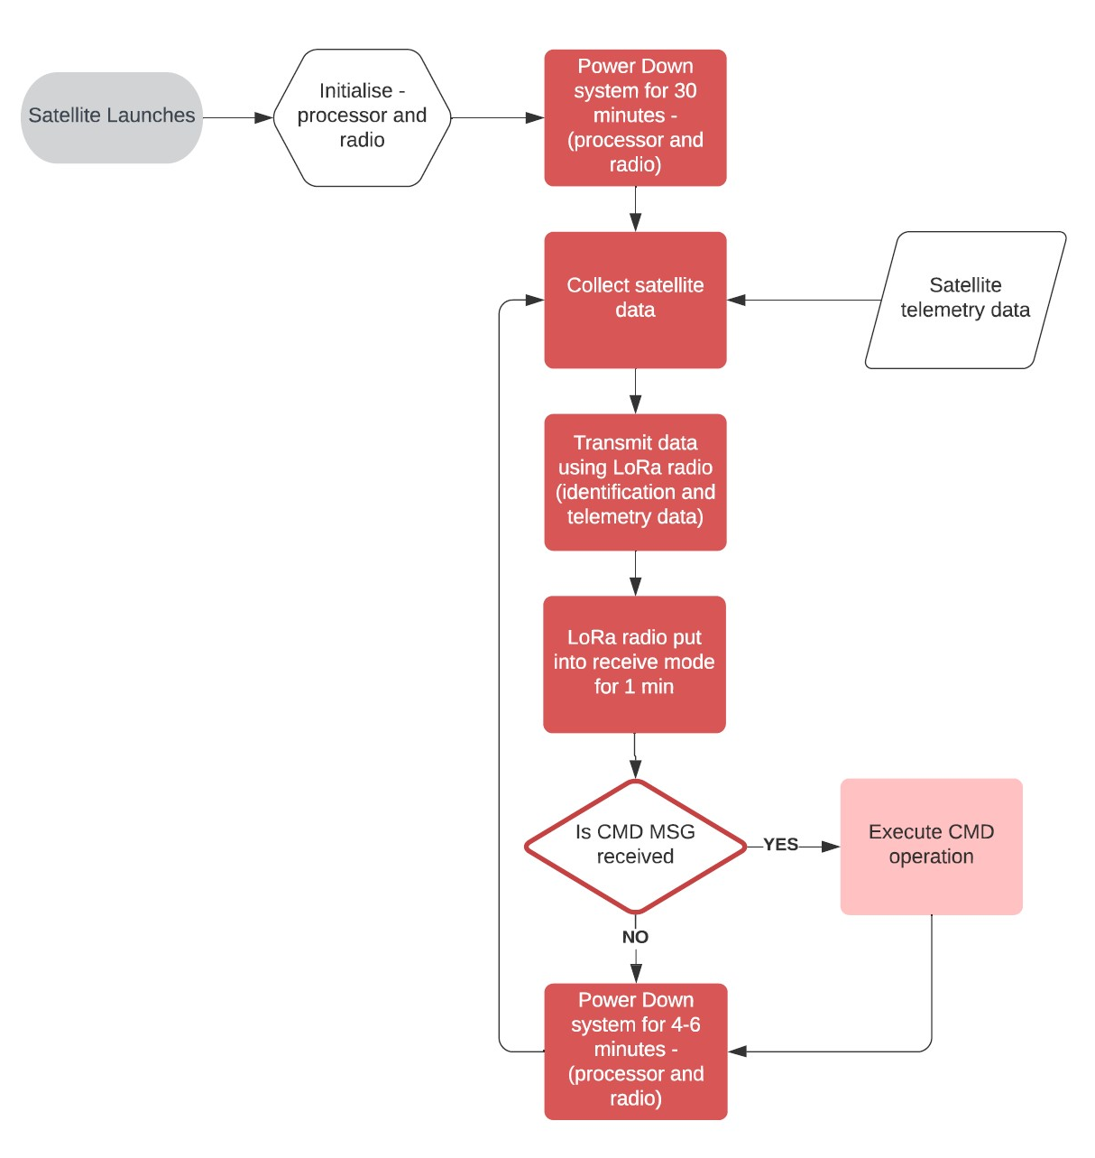
Satellite Radio Beacon
The software cycle for the satellite radio beacon was developed to comply with the following requirements:
Maintain radio silence 30 minutes after release from the launch vehicle
A receive period to receive a command to cease radio transmissions as required by ACMA and ITU
A variable period for the power down phase to prevent transmission synchronisation
Notes:
The software cycle for the radio beacon was developed to comply with the following requirements:
The beacon is required to maintain 30 minutes of radio silence after release from the launch vehicle
The radio must have a period in which it can receive a command to cease transmissions
The power down period of the software cycle must be varied to prevent synchronisation of transmissions
The beacon software operates by powering down the radio and processor for 30 minutes after initialisation
The software then runs through a periodic cycle where:
The telemetry data is collected
Then packaged with the satellite identification and transmitted
The radio is then placed into receive mode for 1 minute
And finally, the processor and radio are powered down for between 4 to 6 minutes

Slide 9
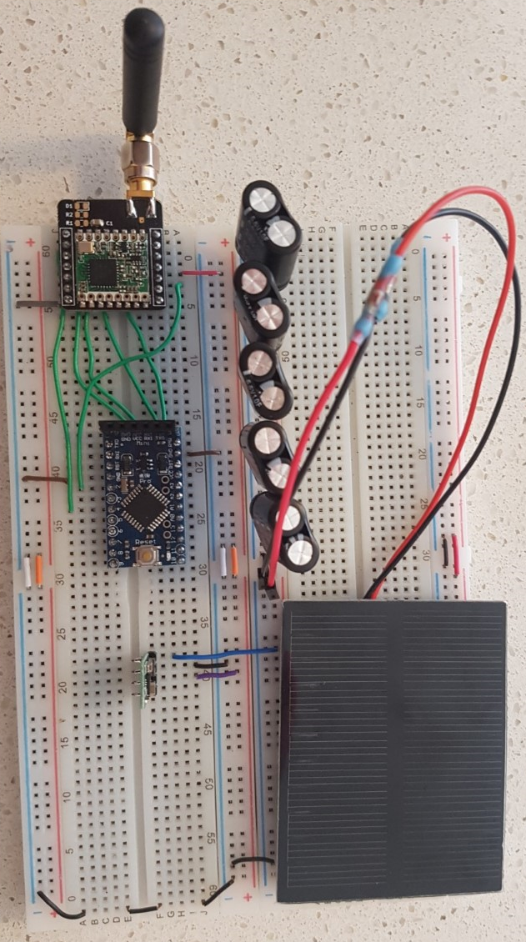
Satellite Radio Beacon
Manufacture of the satellite radio beacon prototype (see right) was a result of the testing carried out to minimise the Size, Weight and Power (SWaP) of each component
Methods to reduce the beacon current consumption:
Placing the LoRa module into sleep mode
Placing the processor into low power mode
Minimizing the receive and transmit phase
Decreasing the TX power and data packet size
Additional observations during the testing:
One solar panel could not support beacon operation without supplementary power
The super-capacitors introduce an 8 and ½ min delay to initialisation
Several radio packets were dropped by the LoRa radio module (investigated in the communications link testing)
Super-capacitor storage
LoRa radio Module
APM Processor Module
DC-DC Buck converter
Silicon solar panel
Notes:
The aim of the satellite beacon design is to minimise Size, Weight and Power (SWaP) of the system, with reducing the current consumption of each component being the focus of testing.
The testing found the following methods to reduce the beacon current consumption:
Placing the LoRa module into sleep mode where possible
Placing the processor into low power mode when practical
Minimizing the receive and transmit phase in the beacon software cycle
Reducing the TX power and data packet size to as small as possible
Some additional observations were made during the testing:
One solar panel could not support the beacon operation when the TX power is greater than 10dBm without a supplementary power source. The addition of the super-capacitor energy storage allows the beacon to operate up to the maximum TX power, 23dBm.
The super-capacitors introduce an 8-and-a-half-minute delay to the system initialisation which can be factored into the launch phase of the software cycle
Several radio packets were observed to be dropped by the LoRa module which was investigated during the comms link testing

Slide 10
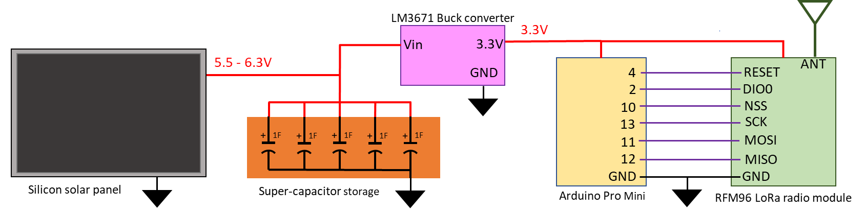
Satellite Radio Beacon
Satellite UHF radio beacon conclusion
A single solar panel can sustain beacon operation when using the super-capacitor storage
The power storage system provides 74 minutes of operation when no power is being generated
A combination of connections remaining to collect satellite telemetry data
Over 50% of the system memory remains for additional software development
Investigation of space-ready components and a PCB design is required before mission-readiness testing can be commenced
Notes:
The ground testing has shown that the operation of satellite UHF radio beacon can be self-sustained using a single silicon solar panel and the super-capacitor energy storage system
The energy storage system can provide 74 minutes of beacon operation when no power is being generated
There is a combination of analogue, digital and serial connections remaining to collect telemetry data from other satellite systems with 50% of the system memory remaining to develop the other software functions
An Investigation into selecting space-ready components and creating a PCB design is required before mission-readiness testing can be commenced

Slide 11
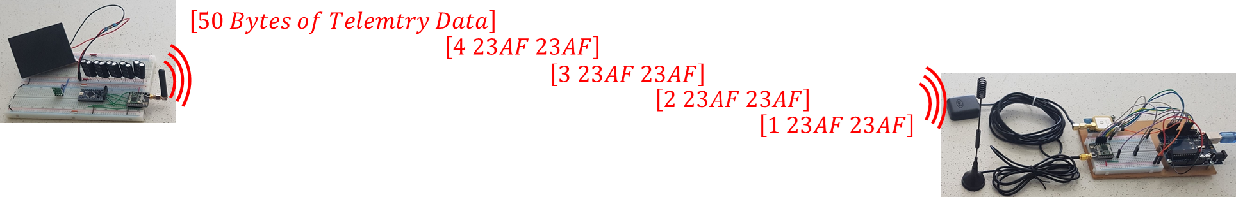
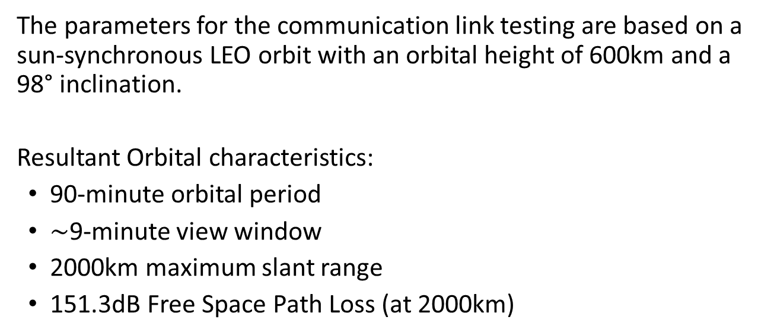
Communications Link
The parameters for the communication link testing are based on a sun-synchronous LEO orbit with an orbital height of 600km and a 98° inclination.
Resultant Orbital characteristics:
90-minute orbital period
$\sim$9-minute view window
2000km maximum slant range
151.3dB Free Space Path Loss (at 2000km)
Notes:
The parameters for the communications link testing are based upon a satellite in a sun-synchronous LEO orbit with a 600kms height and 98° inclination.
This results in a maximum slant range of 2000km or a 151.3dB Free-Space Path loss

Slide 12

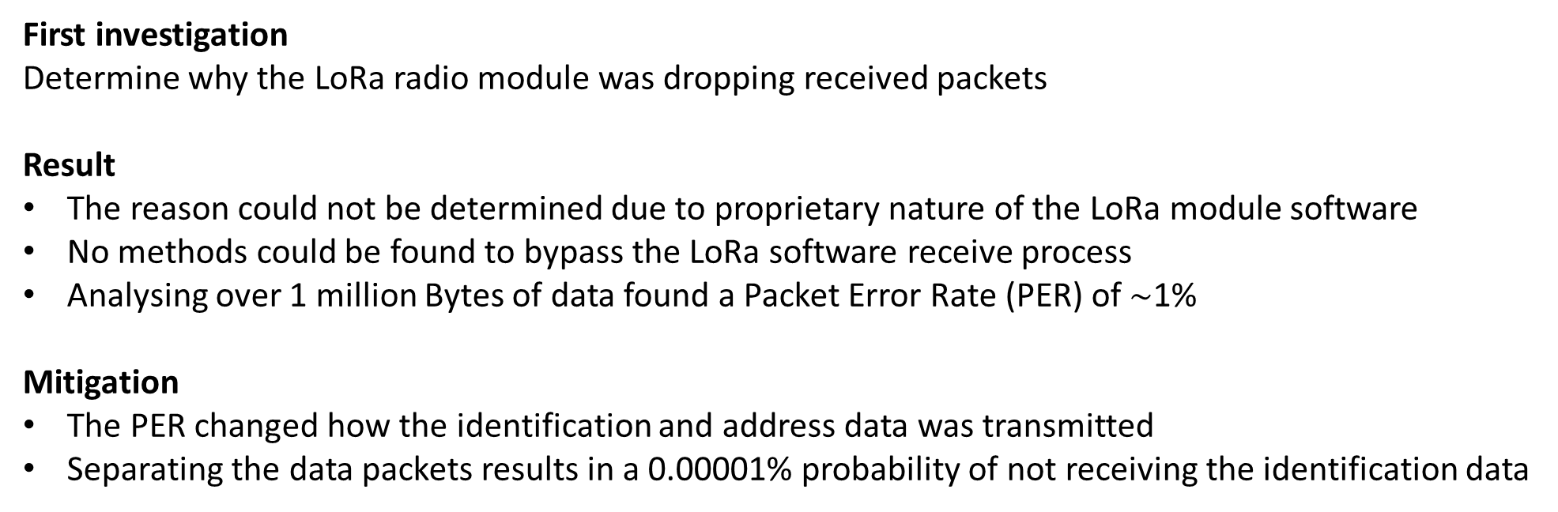
Communications Link
First investigation
Determine why the LoRa radio module was dropping received packets
Result
The reason could not be determined due to proprietary nature of the LoRa module software
No methods could be found to bypass the LoRa software receive process
Analysing over 1 million Bytes of data found a Packet Error Rate (PER) of $\sim$1%
Mitigation
The PER changed how the identification and address data was transmitted
Separating the data packets results in a 0.00001% probability of not receiving the identification data
Notes:
The first investigation carried out was to determine why the LoRa radio module was dropping the received data packets.
The reason for dropped packets could not be determined because of the proprietary nature of the LoRa software and no methods could be found to bypass the software receive process.
The packet error rate found during the testing resulted in changing how the data is transmitted with the identification data being repeated in 4 sequential radio packets followed by a separate telemetry data packet.
This method of transmission significantly reduces the probability of not receiving the satellite unique identification

Slide 13
Communications Link
Second investigation
Verify the UHF communications link for a 2000km slant range (151.3dB FSPL) and determine the LoRa radio software settings and TX power.
Testing procedure
Receiver sensitivity estimated using the LoRa modem calculator tool (available from Semtech)
The link budget was calculated for various TX power (5, 10, 15 and 20dBm)
The results were verified with the ground-based testing
The radio settings used for testing were from the open-sourced RadioHead library default settings
Notes:
The next investigation verified the comms data link for a 2000km range with the results used to determine the LoRa radio software settings and TX power
The first step in the testing procedure was to estimate the LoRa receiver sensitivity using the manufacturers calculator tool
Followed by to calculating the communications link budget using various TX Power levels
And the final step verifying the calculated results with the ground-based testing
The LoRa radio software settings was obtained from the default settings of the open-sourced RadioHead packet radio library

Slide 14
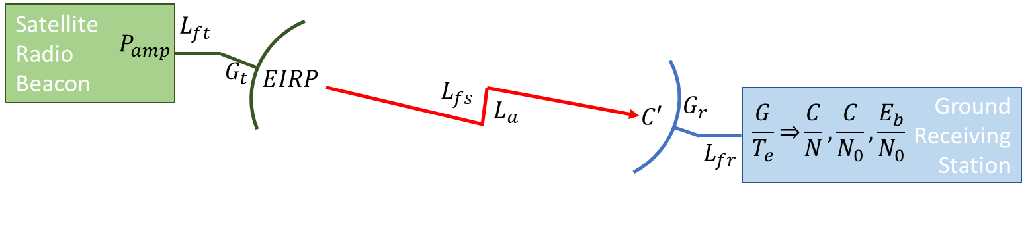
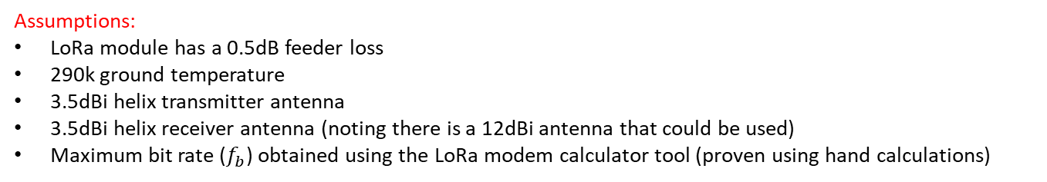
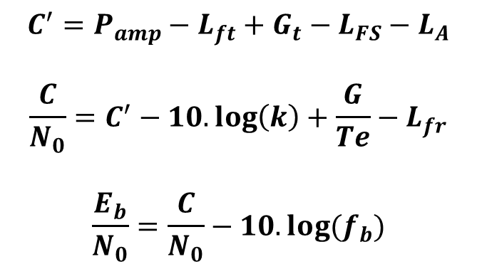
Communications Link
Link Budget Calculations
$$C^{′}=P_{amp}−L_{ft}+G_{t}−L_{FS}−L_{A}$$
$$\frac{C}{N_{0}}=C^{′}−10.\log\left(k\right)+\frac{G}{Te}−L_{fr}$$
$$\frac{E_{b}}{N_{0}}=\frac{C}{N_{0}}−10.log⁡(f_{b})$$
Assumptions:
LoRa module has a 0.5dB feeder loss
290k ground temperature
3.5dBi helix transmitter antenna
3.5dBi helix receiver antenna (noting there is a 12dBi antenna that could be used)
Maximum bit rate ($f_{b}$) obtained using the LoRa modem calculator tool (proven using hand calculations)
Calculated values for the communications link budget
Notes:
The simplified equations and assumptions used for the link budget calculation are presented on the slide and were used for the 0, 2 and 3 default radio settings with various TX powers.
A TX power of 15dbm results in a received Eb/N0 greater than 10 when the 2 or 3 default radio settings are used, with the 2 default settings having slightly better results

Slide 15
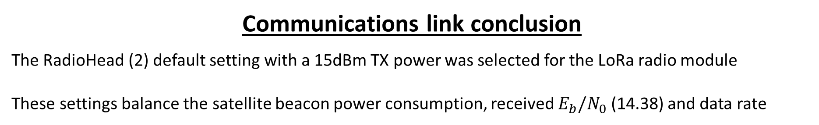
Communications Link
Ground-Based Testing
Two LoRa modules were connected with coaxial cables and attenuation that represents the maximum FSPL (and calculated range) for the consistent reception of data packets
Results of the ground-based communication link testing
Communications link conclusion
The RadioHead (2) default setting with a 15dBm TX power was selected for the LoRa radio module
These settings balance the satellite beacon power consumption, received $E_{b}/N_{0}$ (14.38) and data rate
Notes:
The ground-based testing was carried out by connecting two LoRa modules with coaxial cables and varying the attenuation to determine the maximum FSPL and calculated range for which the receiver collects consistent data.
The results of the ground testing were consistent with the LoRa calculator estimates and the link budget calculations
The RadioHead (2) default settings with a TX power of 15dBm was selected for the LoRa radio module to balance the satellite beacon power requirements, the received Eb/N0 and transmitted data rate.
These settings result in an Eb/No of 14.38 which allows a safety margin for unaccounted losses

Slide 16
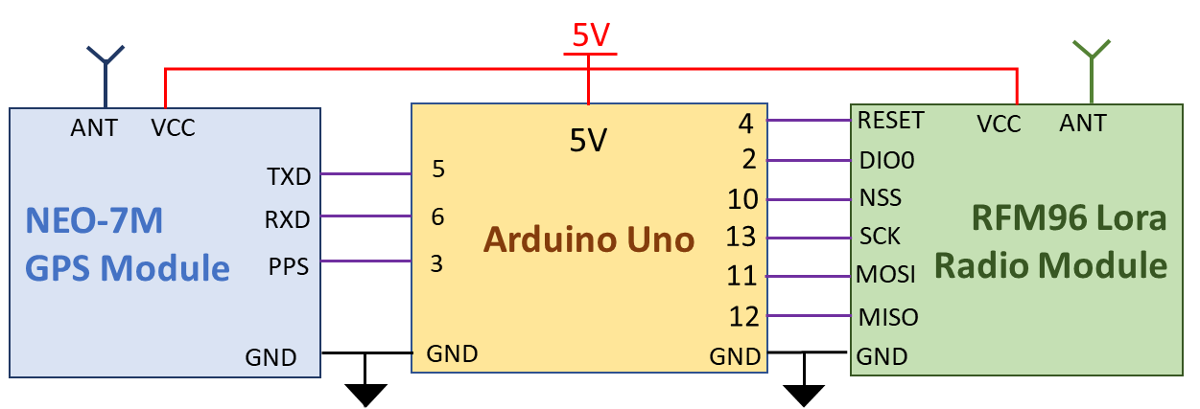
Ground Receiving Station
The ground receiving station must be able to capture the transmitted data, record the precise time of arrival of the RF signals, determine its global location and pass data to a peripheral device.
To achieve these aims the ground receiving station contains:
Processor module – Arduino Uno development board with an ATMEGA328P processor and 16MHz oscillator
Radio Module – RFM96 LoRa radio module
GPS Module – U-Blox NEO-7M GNSS module with a Pulse-per-Second signal synchronized to Coordinated Universal Time (UTC)
Notes:
The ground receiving station must be able to capture the transmitted data, record the precise time of arrival of the RF signals, determine its global location and pass data to a peripheral device.
To achieve these aims the ground receiving station contains:
Processor module – using an Arduino Uno board
Radio transceiver – which is the RFM96 LoRa radio module
GPS Module – that is a U-Blox GNSS module with a Pulse-per-Second signal

Slide 17
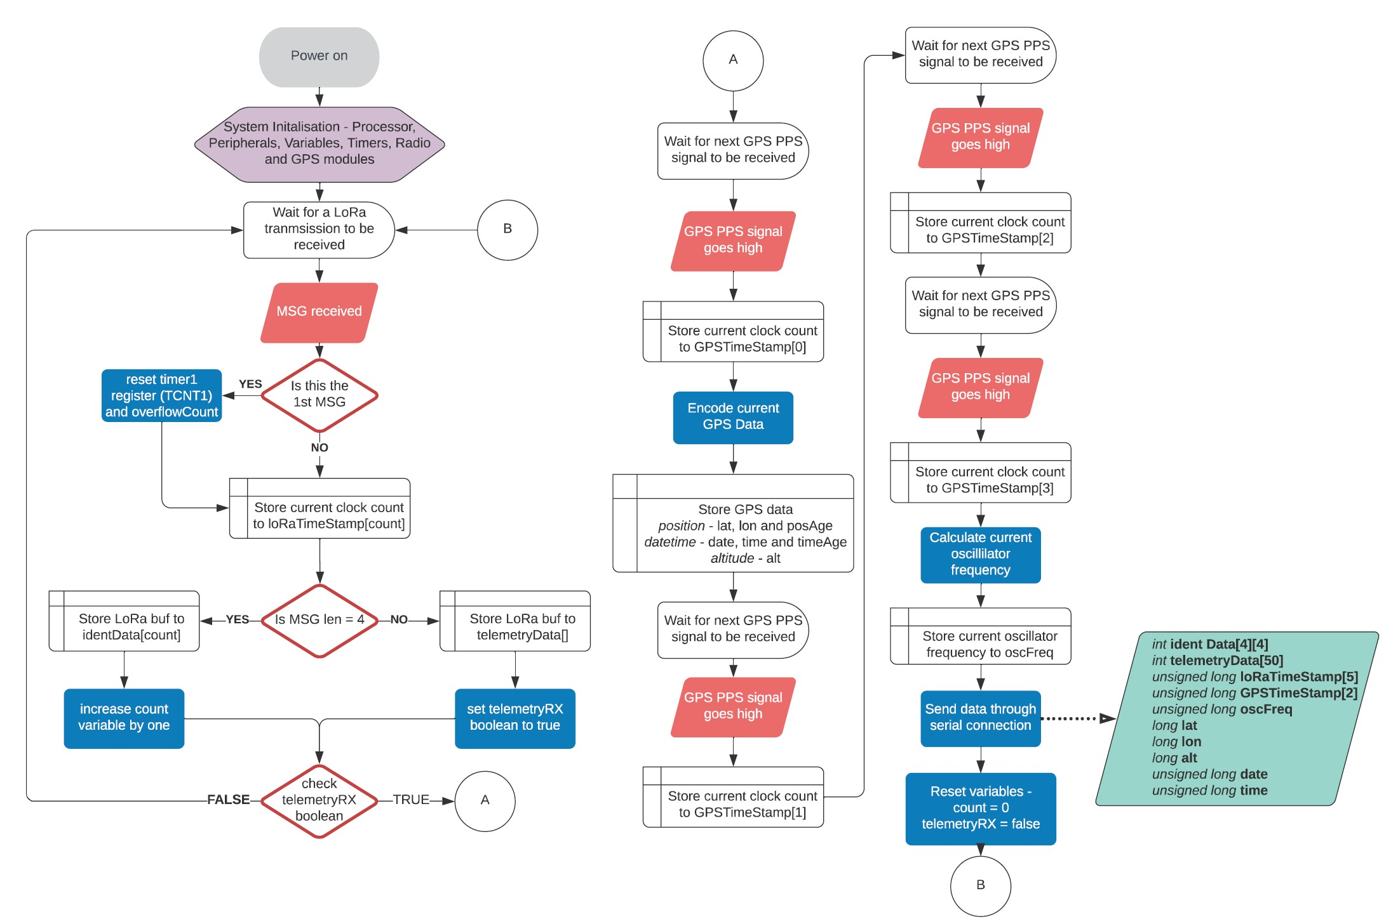
Ground Receiving Station
Ground receiving station software cycle
Ground station captures the data from each received packet
The number of processor clock cycles that have occurred since the 1st Received signal is timestamped (the 1st signal resets the clock count to zero)
After the telemetry data is received, the GNSS data is captured and timestamped at the next PPS pulse,
The number of clock cycles between the next 3 GNSS PPS signals are collected and averaged to determine the true oscillator frequency
The collected data is passed through the serial connection to a peripheral device
The true oscillator frequency is used to determine the length of the processors clock cycle
This value is used to calculate the time of arrival of each timestamp with reference to the captured UTC
Notes:
The ground receiving station software cycle operates by:
Capturing the data from each received packet and timestamping the number of processor clock cycles that have occurred since the first received signal
After the telemetry data is received, the GNSS data is captured and timestamped at the next PPS pulse
The number of clock cycles between the next 3 PPS signals are collected and averaged to determine the true oscillator frequency and calculate the clock cycle length
The collected data is then passed to a peripheral device which uses the calculated cycle length and signal timestamps to determine the time of arrival of each signal referenced to the captured UTC

Slide 18
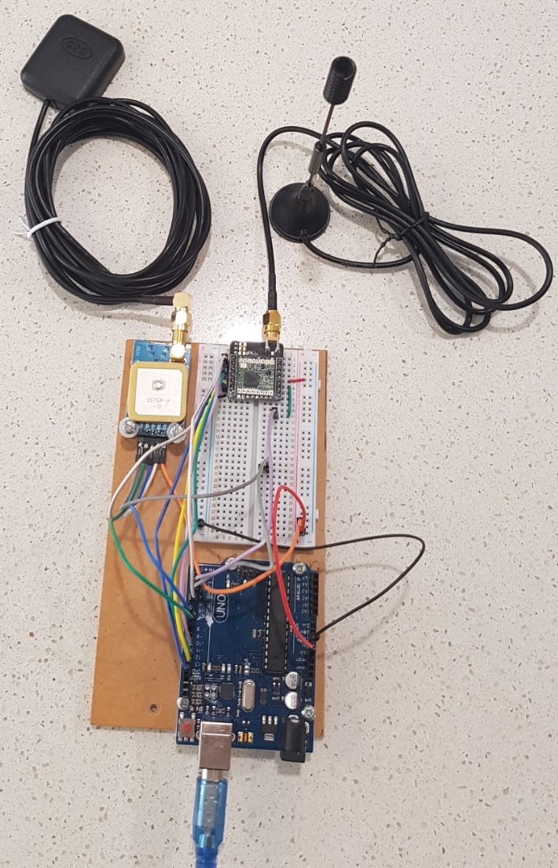
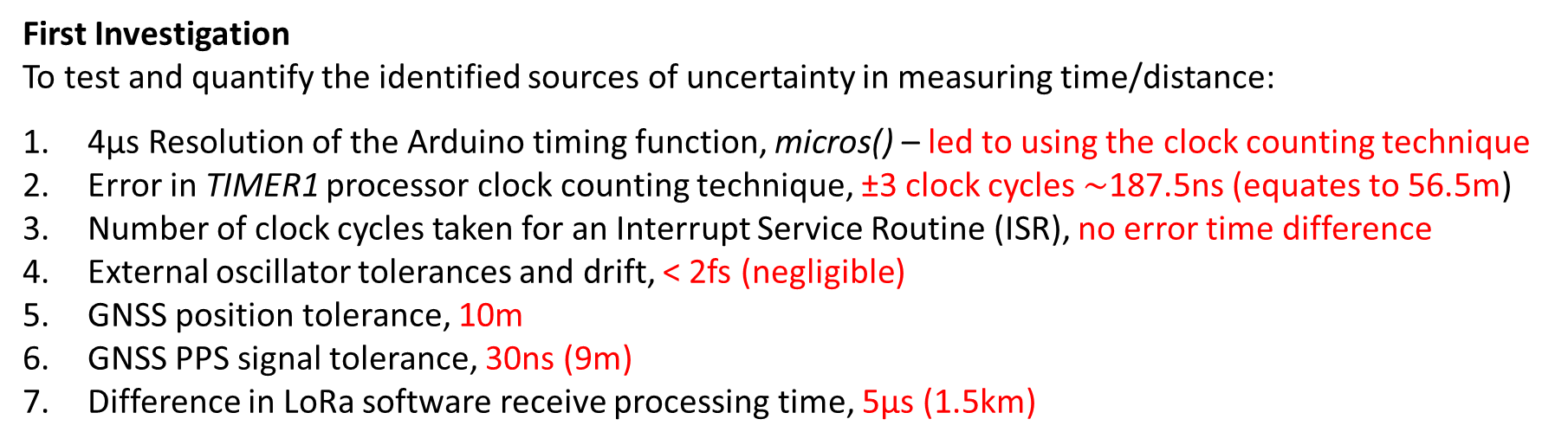
Ground Receiving Station
First Investigation
To test and quantify the identified sources of uncertainty in measuring time/distance:
4µs Resolution of the Arduino timing function, micros() – led to using the clock counting technique
Error in TIMER1 processor clock counting technique, ±3 clock cycles $\sim$187.5ns (equates to 56.5m)
Number of clock cycles taken for an Interrupt Service Routine (ISR), no error time difference
External oscillator tolerances and drift, < 2fs (negligible)
GNSS position tolerance, 10m
GNSS PPS signal tolerance, 30ns (9m)
Difference in LoRa software receive processing time, 5µs (1.5km)
Results
The total estimated uncertainty in the time difference of arrival between two ground stations was 5.25µs.
This equates to an uncertainty of 1.58km when estimating the position using the TDOA calculation technique.
Notes:
The first investigation was to test and quantify the identified sources of uncertainty in measuring time or distance which were found in:
The Arduino timing function resolution, which led to using the clock counting technique
The Timer1 processor clock counting technique itself
The Initialisation of the Interrupt Service Routine process
The Oscillator tolerances and drift
The GNSS position and PPS signal tolerance
And, the difference in LoRa processing time
The total estimated uncertainty in the time difference of arrival between two ground stations is 5.25µs, which equates to an error of 1.58km when estimating the position using the TDOA calculation technique.

Slide 19
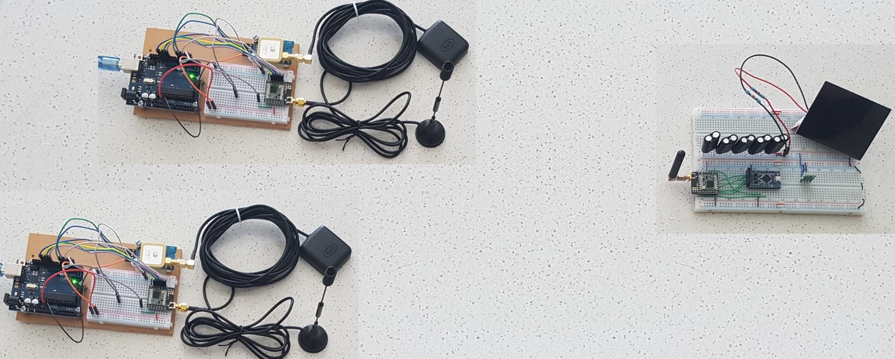
Ground Receiving Station
Final verification Testing
Two ground stations were uniformly connected to a single radio beacon
The measured time difference of arrival is the level of uncertainty in measuring time
Results
Total measured uncertainty was 1.7ms, which equates to TDOA distance calculation error is 510km
Ground Receiving station conclusion
The estimated uncertainty in satellite position was 1.58km, the verification test revealed an uncertainty of 510km
The mostly likely cause of the large uncertainty is the implementation of the processor clock counting ISR
The clock counting technique requires examination with a focus on timer capture mode, before a reliable TDOA algorithm can be used to estimate the satellites position.
Notes:
For the verification testing, a single transmitted signal was received by 2 ground stations at the exact same time with the measured time difference in arrival representing the total uncertainty of the time measuring technique
The results show a total measured uncertainty of 1.7ms which equates to a positional calculation error of 510km which is much larger than expected
The considerable increase in uncertainty is most likely caused by the implementation of the processor clock counting ISR
The clock counting technique requires examination, with a focus on timer capture mode before a reliable TDOA algorithm can be used to estimate the satellites position.

Slide 20
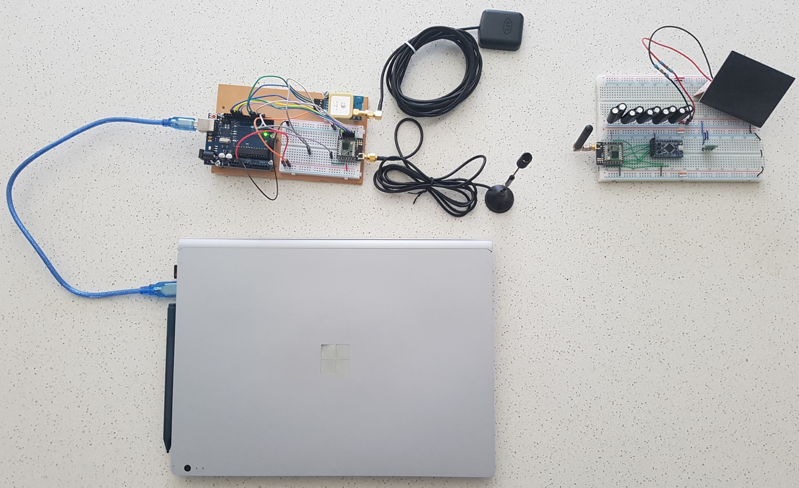
Conclusion
Project aim: Prototype design for a self-contained and independent radio beacon
Project extension: Prototype design for a ground receiving station
The Satellite UHF radio beacon system has been tested and verified to:
Sustain beacon operation without any input
Operate for a 2000km range
Transmit the satellite identification to the ground station
Transmit satellite telemetry and health data
Execute a satellite control command from a ground station
Measure a signal Time of Arrival with a 1.7ms tolerance (510km position calculation uncertainty)
The initial design for the small satellite UHF radio beacon system has proven the concept for the small satellite beacon Identification, Telemetry and Control
Further investigation is required to obtain a reliable and accurate tracking function
Notes:
The aim of this project was to produce an initial prototype design for a self-contained and independent radio beacon that can transmit data from a small satellite in LEO
The project was extended to include a prototype design for a ground receiving station with a tracking function.
The satellite radio beacon system has been tested and verified to
Sustain beacon operation without any input
Operate for a 2000km range
Transmit the satellite identification from the beacon to a ground station
Transmit satellite telemetry and health data from the beacon to a ground station
Execute a satellite control command from a ground station
Measure a signals Time of Arrival with a 1.7ms tolerance
In summary, the initial design for the small satellite UHF radio beacon system has proven the concept for the Identification, Telemetry and Control function which addresses the problems of
Uniquely identifying a satellite
Reducing the failure rate by identifying cause of failure
Reducing space debris by providing a command pathway for on-orbit correction
Further investigation is required to obtain a reliable and accurate tracking function that address the reliance on costly space monitoring equipment.

Slide 21
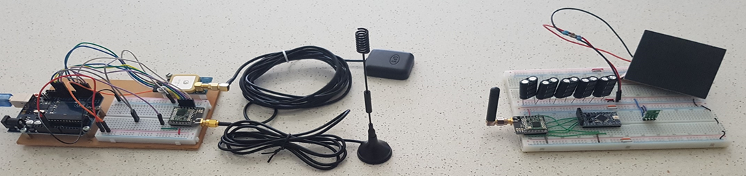
Recommendations
Further research is required to reduce the uncertainty of time measurement in the ground station, with a focus on the processor Timer1 clock counting method
If the uncertainty of time measurement is reduced, then the next step will be to:
Implement a TDOA algorithm that calculates estimated position based on Lat/Long Develop a user interface program for the ground receiving station
Develop a server system for the collection and processing of ground station data
Produce a satellite radio beacon design ready for space mission readiness testing
Notes:
It is recommended that further research is required to reduce the uncertainty of time measurement in the ground station, with a focus on the processor Timer1 clock counting method
If the uncertainty of time measurement is reduced, then the next step will be to:
Implement a TDOA algorithm that calculates estimated position based on Lat/Long
Develop a user interface program for the ground receiving station
Develop a server system for the collection and processing of ground station data
Produce a satellite radio beacon design ready for space mission readiness testing

